Slide 1



MEMBERSHIP CAMPAIGN
The Chamber Effect
March – May 2023

Slide 2
DELIVERABLES
CHANNELS
Videos
Photos
Landing Page
Advertising
Social Media
Weekly E-Newsletter

Slide 3
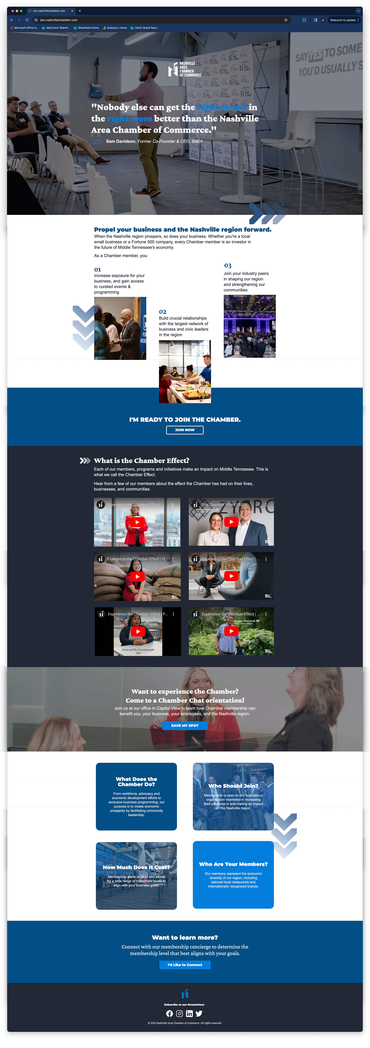
Landing Page

Slide 4



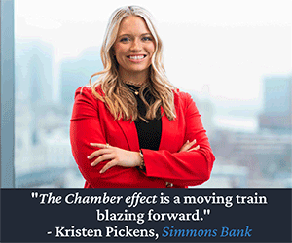
Kristin | SIMMONS BANK
Print Ad
Digital Ads (rotating GIFs – click to play)

Slide 5
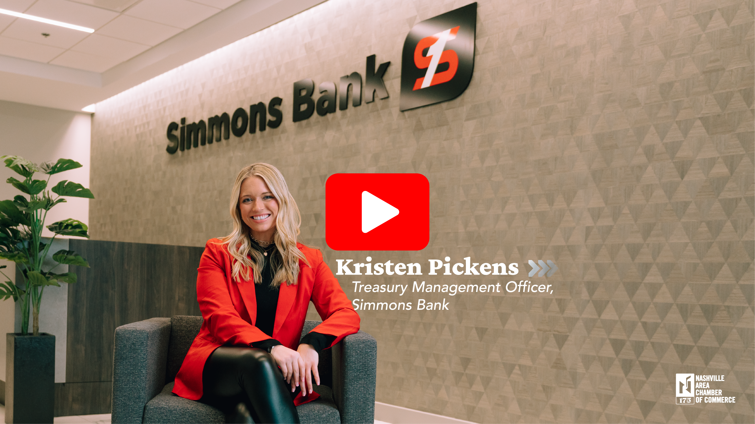
Video Testimonial – click to play

Slide 6



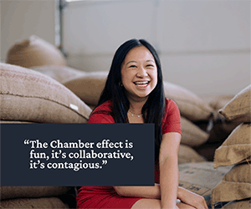
Karen | HUMPHREY’S STREET COFFEE
Print Ad
Digital Ads (rotating GIFs – click to play)

Slide 7
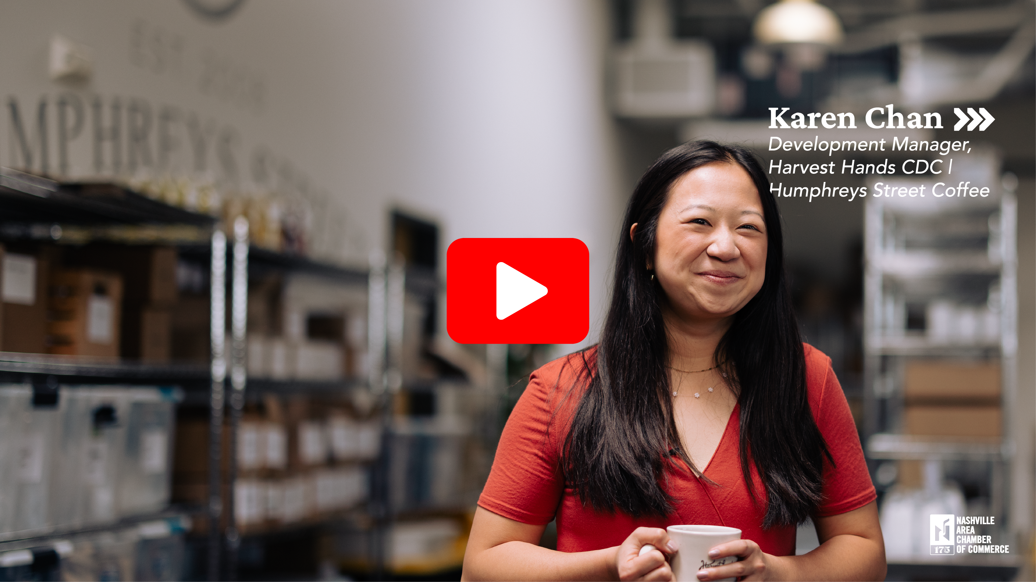
Video Testimonial – click to play

Slide 8



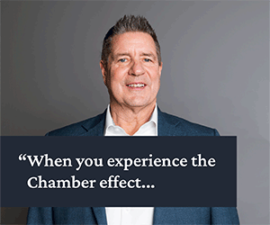
Print Ad
Dennis | BGSF
Digital Ads (rotating GIFs – click to play)

Slide 9
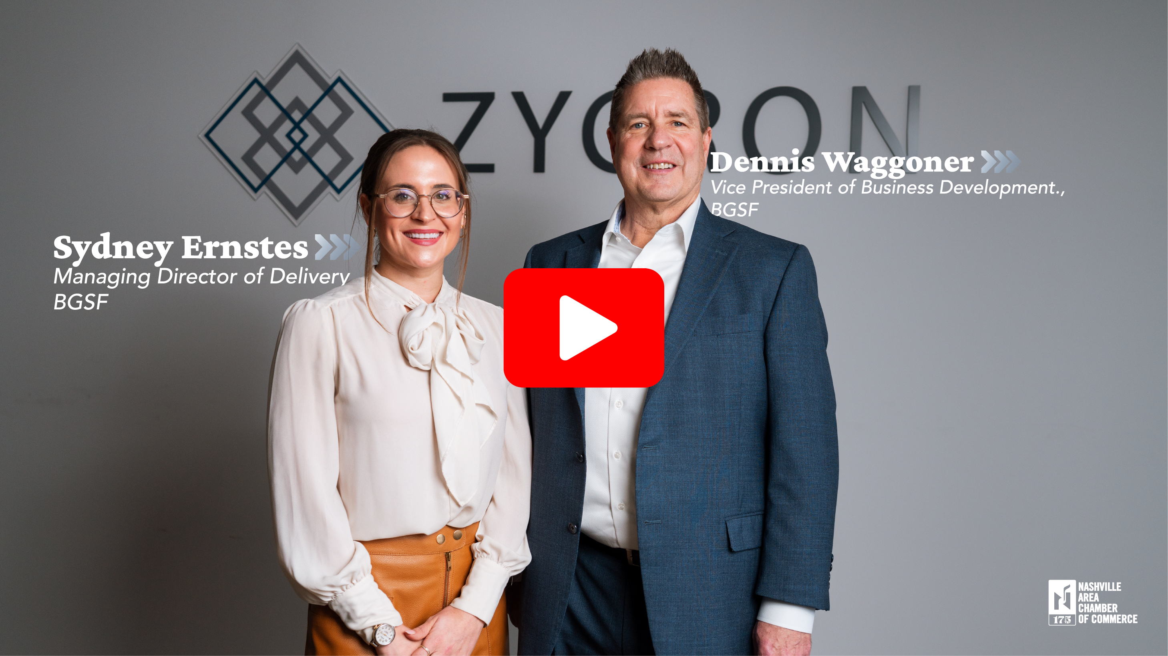
Video Testimonial – click to play

Slide 10
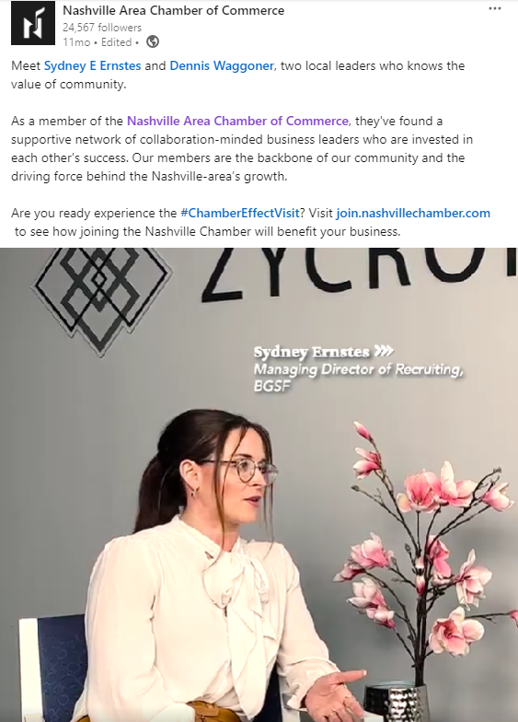
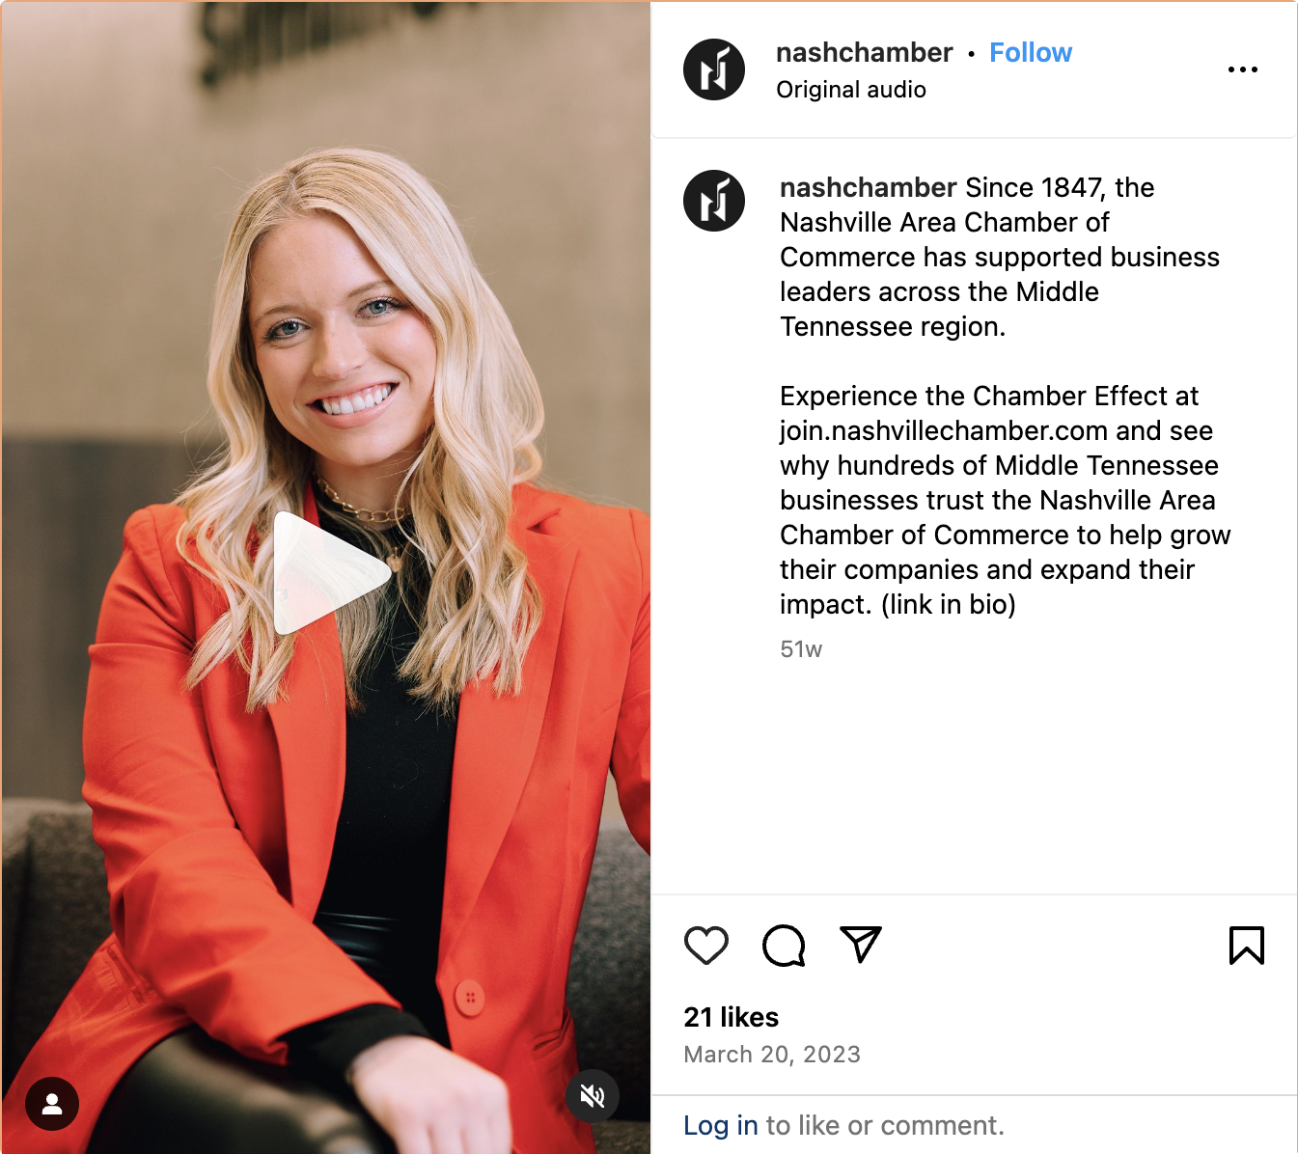
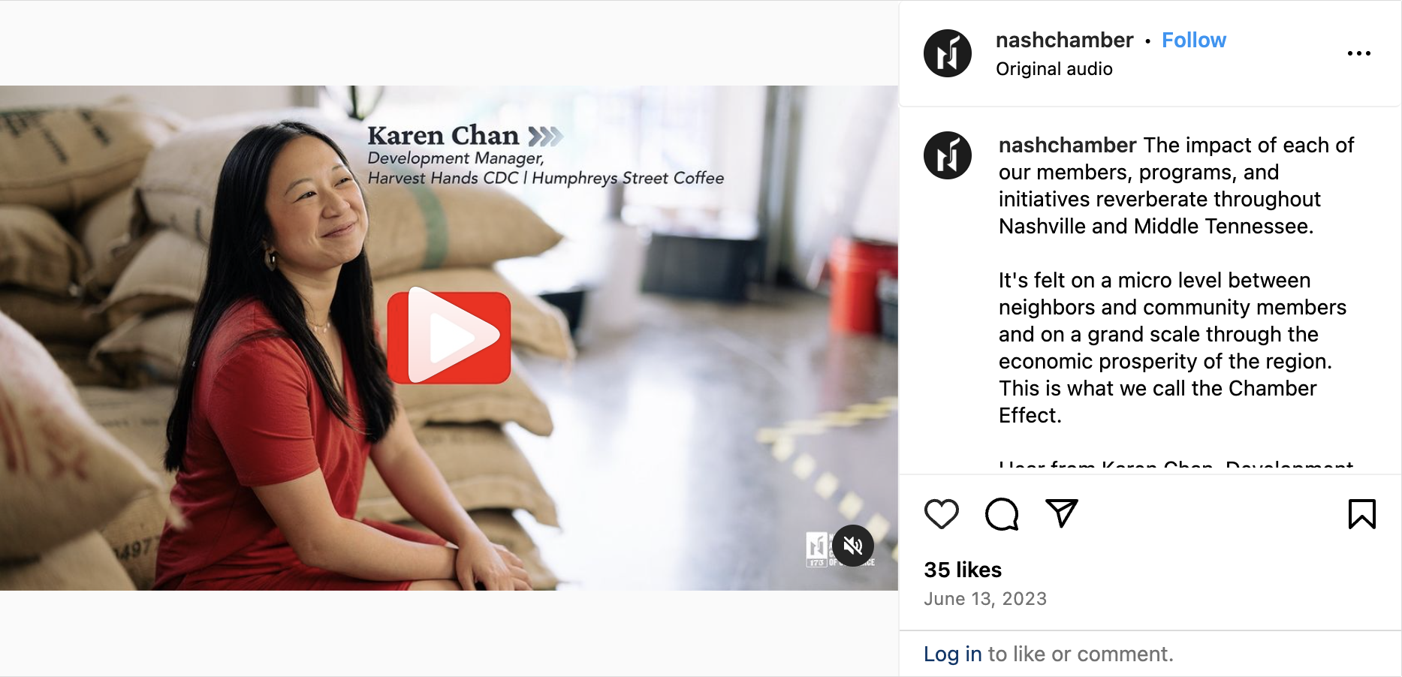
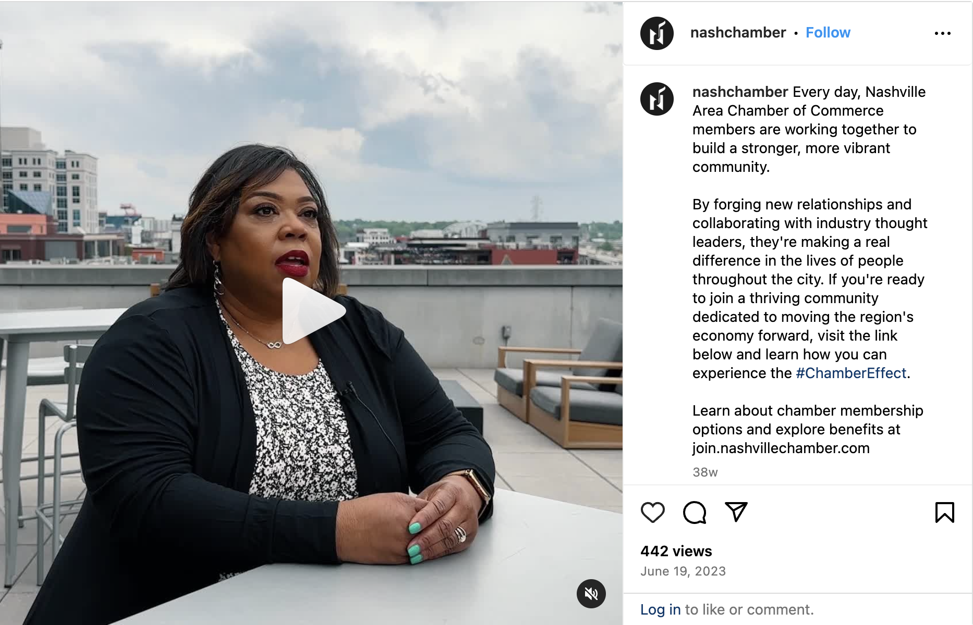
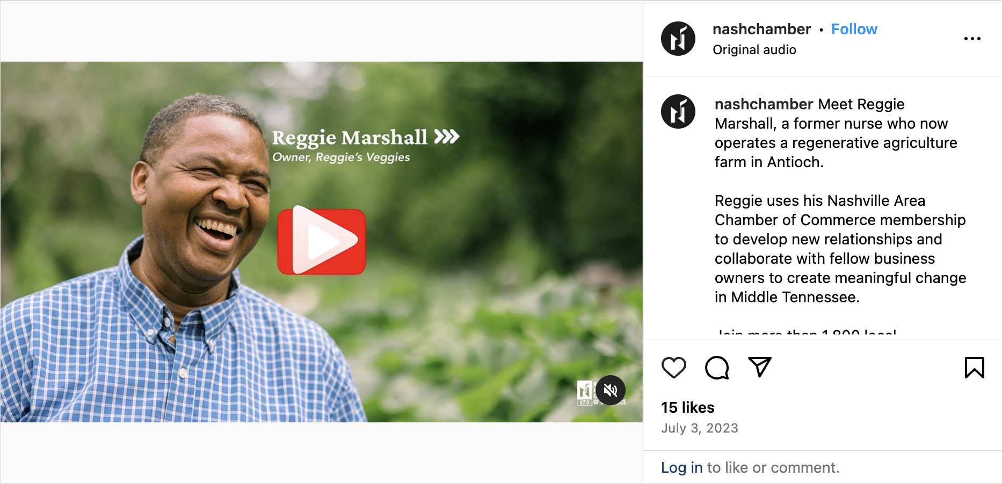
Social Media Content
CLICK IMAGE TO VIEW POST

Slide 11
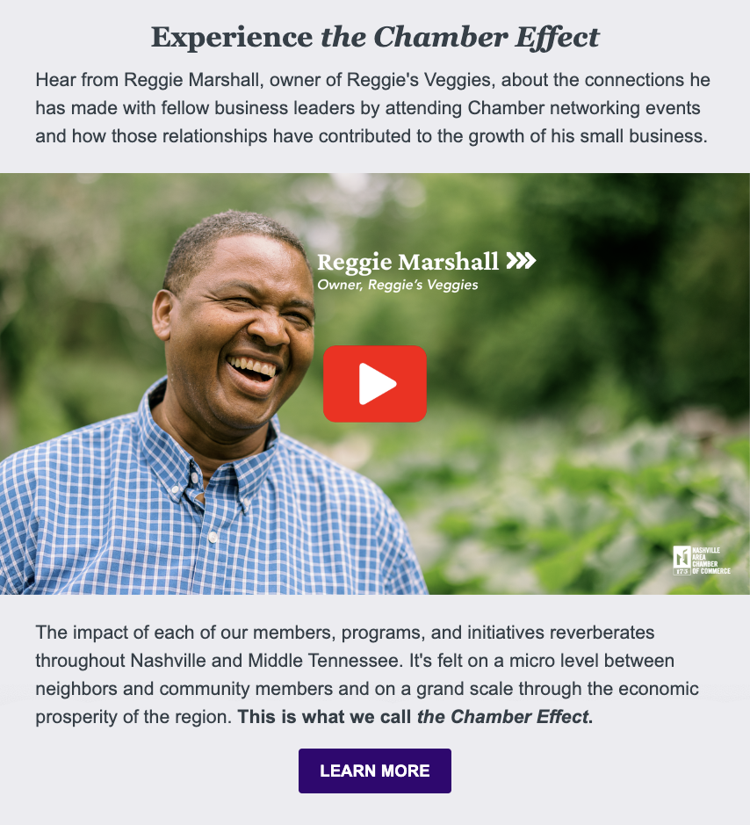
E-Newsletter Feature
CLICK IMAGE TO VIEW NEWSLETTER

Slide 12
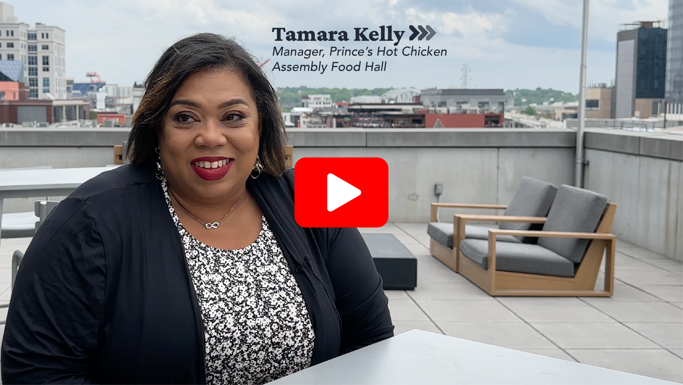

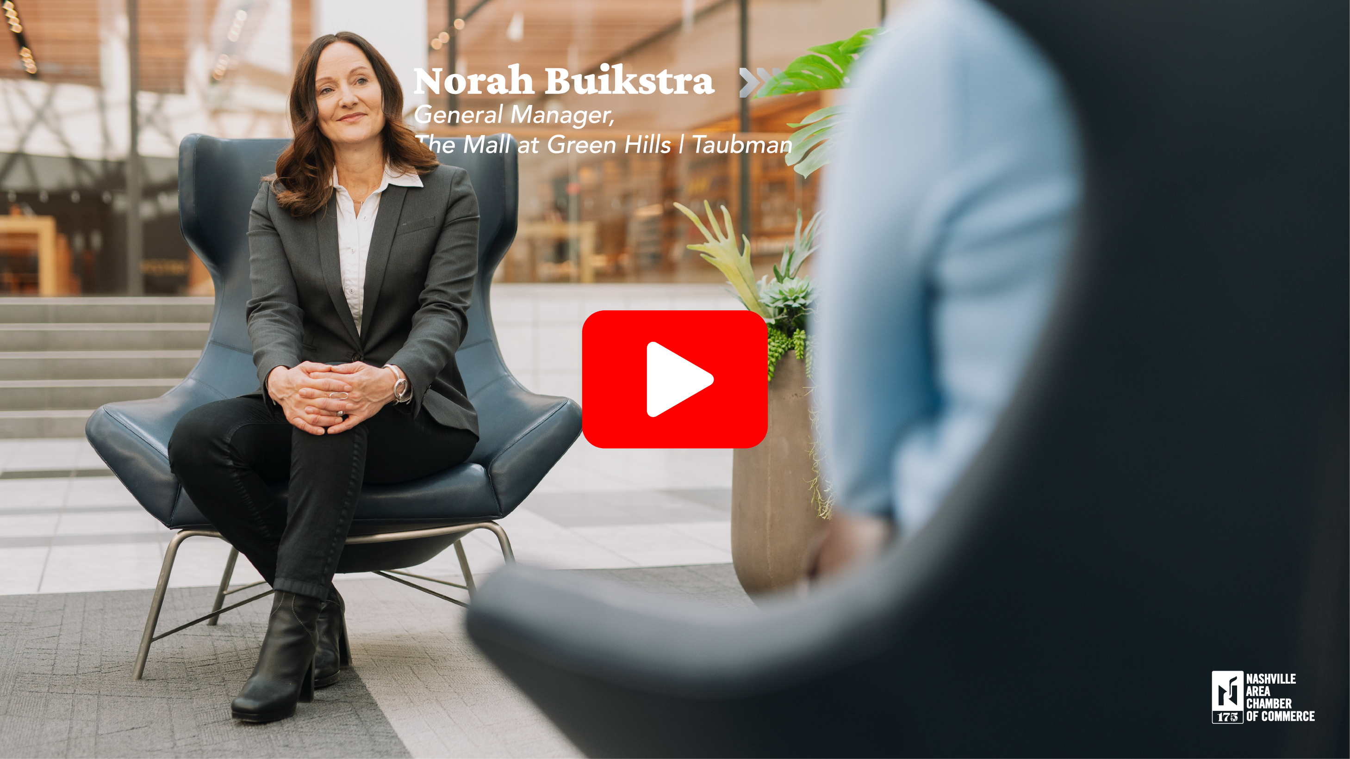
Additional Video Testimonials
CLICK IMAGE TO VIEW VIDEO. VIEW CHAMBER EFFECT YOUTUBE PLAYLIST HERE .

